Slide 1

FEDERAL UNIVERSITY OYE-EKITI
Ekiti State, Nigeria • Department of Computer Science
Depression Detection using
Shifted Windows (SWIN) Transformer
Student: Olagoroye Samuel Akolawole Matric No: CSC/2021/1080
Supervisor: Dr. C.Y. Daramola

Slide 2
Table of Contents
01
Background & Problem
08
Experimental Setup
02
Relevance of the Study
09
Results: Swin vs. TCN Baseline
03
Literature Review
10
Results: ROC Curve
04
Aim & Objectives
11
Ablation Study
05
Methodology
12
Conclusion
06
Proposed Model: Swin Transformer
13
References
07
Dataset: LMVD
Depression Detection using Swin Transformer
2 / 16

Slide 3
Background & Problem
300M+
< 300
20–35%
people affected by
depression worldwide (WHO)
practicing psychiatrists for
over 200 million Nigerians
estimated prevalence among
Nigerian university students
PHQ-9-style self-report depends on patients accurately describing their own state but depression itself can distort memory, and stigma discourages honest answers. Facial behaviour is harder to consciously fake, making it a promising, low-cost screening signal.
Depression Detection using Swin Transformer
3 / 16

Slide 4
Relevance of the Study
No Specialists
Early Flagging
Local Baseline
Screens with only a
phone camera and mic
Surfaces at-risk cases
before a referral exists
Grounds future mental-
health AI in local data
For a country of over 200 million people with fewer than 300 practicing psychiatrists, low-cost automated pre-screening is not a luxury; it is a practical bridge to care, especially for university students who rarely have access to campus mental-health services.
Depression Detection using Swin Transformer
4 / 16

Slide 5
Literature Review
Key studies underpinning the dataset, architecture, and fusion strategy adopted in this project
Author & Year | Topic | Contribution | Limitation
Yoon et al. (2022) | Audio-visual, in-the-wild vlog detection | Introduced D-Vlog and a cross-modal attention transformer that outperformed early and late fusion | Only 961 recordings — too small to train a transformer like Swin from scratch
He et al. (2024) | Large-scale multimodal vlog dataset | Released LMVD (1,823 samples) with VGGish/OpenFace features and the lightweight MDDformer baseline (F1 76.85%) | Baseline uses a standard transformer, not Swin's hierarchical windowed attention
Liu et al. (2021) | Vision Transformer architecture | Proposed the Swin Transformer, using shifted local windows to cut attention cost from quadratic to near-linear | Designed for natural images, not reshaped behavioural feature sequences
He et al. (2024) | Video Swin Transformer for depression scoring | Applied a Video Swin Transformer with fine-grained facial features, beating CNN and plain-ViT baselines | Video only; audio-visual fusion limited to simple channel attention, not bidirectional cross-attention
Haque et al. (2025a) | Multimodal fusion transformer | Blended late and intermediate fusion; best published F1 on LMVD at the time (90.48%) | Simpler than full bidirectional cross-attention; no ImageNet transfer learning
Bai, Kolter & Koltun (2018) | Temporal Convolutional Network (TCN) | Dilated causal convolutions giving a long receptive field with parallel processing — a strong baseline | Fixed dilation growth, not attention; no cross-modal fusion mechanism
Depression Detection using Swin Transformer
5 / 16

Slide 6
Aim & Objectives
Aim: The aim of this study is to Detect depression using a Shifted Windows (Swin) Transformer
The objectives are to:
design a Swin Transformer-based classification model adapted to fit the LMVD dataset extracted features.
train a baseline CNN model on the same data using the same five metrics, so a fair comparison can be made between the two architectures.
evaluate the trained model using five standard classification metrics: accuracy, precision, recall, F1-score and AUC-ROC, to get a fuller picture of how well it separates depressed from non-depressed individuals.
compare the results of the Swin Transformer and the CNN baseline, and discuss what the difference, if any, suggests about the value of the shifted-window attention mechanism for this kind of data.
Depression Detection using Swin Transformer
6 / 16

Slide 7
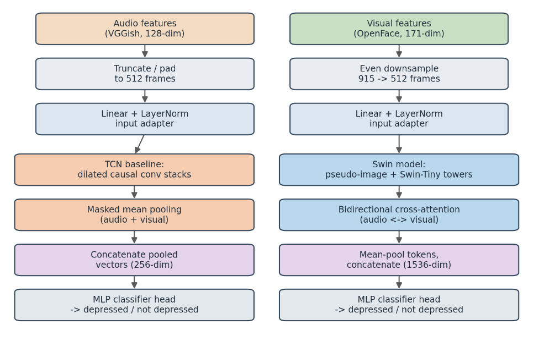
Methodology
Two-stream pipeline, from raw LMVD features to a prediction
Audio (VGGish) and facial (OpenFace) features are extracted and standardized to the same sequence length (512 frames).
TCN baseline: Each feature sequence is processed separately, then both are combined for depression classification.
Swin Transformer: Audio and visual features are processed together using cross-attention before the final depression prediction.
Depression Detection using Swin Transformer
7 / 16

Slide 8
Architecture of the Proposed Model: Swin Transformer
The Swin Transformer looks at small groups of frames at a time, then shifts those groups in each layer so information gradually spreads across the whole clip building up from short-term cues like a vocal dip or a flicker of expression to longer-term mood patterns, without the heavy cost of comparing every frame to every other frame.
Two Swin towers process audio and facial features separately, then a cross-attention step lets them share information for example, linking a change in tone of voice to a matching facial cue — before a final layer predicts depressed or non-depressed.
Depression Detection using Swin Transformer
8 / 16

Slide 9
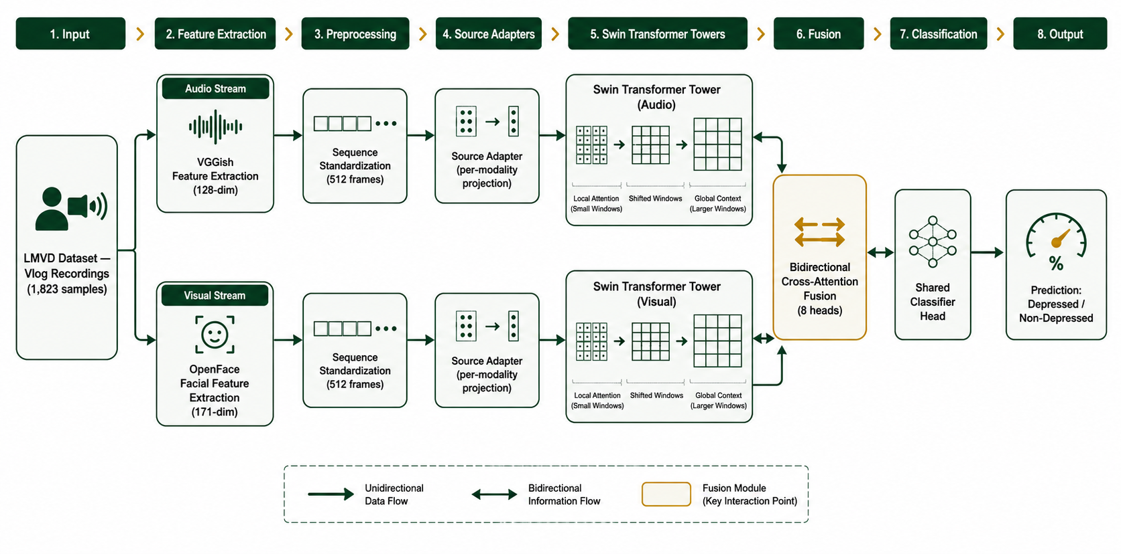
Proposed architecture of the SWIN implementation

Slide 10
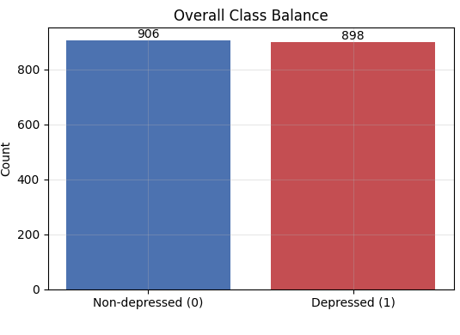
Dataset: LMVD
Large-scale Multimodal Vlog Dataset (He et al., 2024)
1,804
906 / 898
70/15/15
usable samples
after cleaning
non-depressed /
depressed samples
train / val / test
split (stratified)
Classes are almost perfectly balanced, so no class-weighting was needed in the loss function.
Depression Detection using Swin Transformer
9 / 16

Slide 11
Experimental Setup
Optimiser
AdamW · differential learning rate (backbone 1e-5, head 1e-4)
Early stopping
Patience of 7 epochs on validation F1 · capped at 40 epochs
Reproducibility
3 fixed seeds (42, 123, 2024) · results reported as mean ± std
Metrics
Accuracy, precision, recall, F1-score and AUC-ROC
Hardware
Kaggle free-tier NVIDIA T4 GPU · batch size of 16
Depression Detection using Swin Transformer
10 / 16

Slide 12
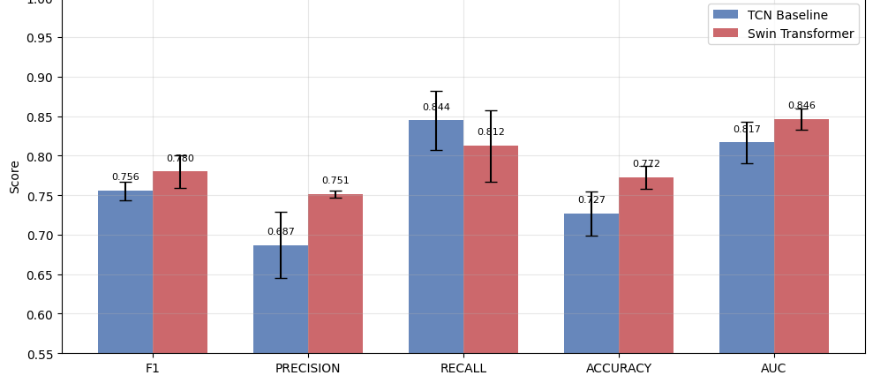
Results: Swin vs. TCN Baseline
Mean across 3 seeds, LMVD test set
Metric
TCN
Swin
Δ
F1
0.756
0.780
+2.4
Precision
0.687
0.751
+6.4
Recall
0.844
0.812
−3.2
Accuracy
0.727
0.772
+4.6
AUC-ROC
0.817
0.846
+3.0
Swin wins on 4 of 5 metrics — AUC improves from 0.817 to 0.846.
Depression Detection using Swin Transformer
11 / 16

Slide 13
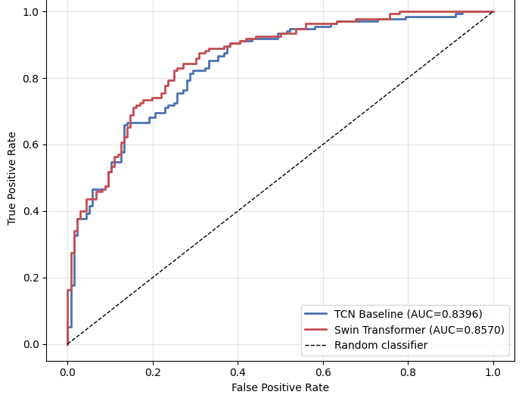
Results: ROC Curve
Best seed per model — Swin (seed 123) vs TCN (seed 2024)
0.857
Swin AUC
0.840
TCN AUC
Swin's curve sits above the baseline's across nearly the whole plot — a higher true-positive rate at almost any false-positive rate a screener would tolerate.
Depression Detection using Swin Transformer
12 / 16

Slide 14
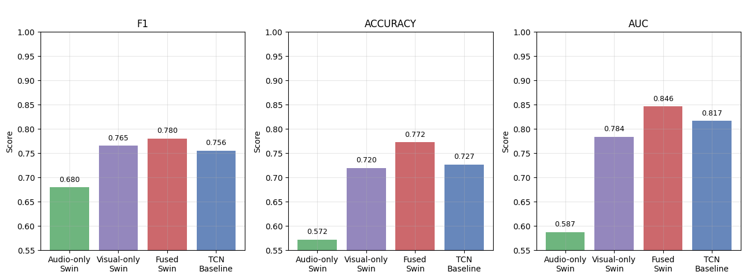
Ablation Study
Audio alone is barely above chance (0.587 AUC); visual alone reaches 0.784; fusion lifts this to 0.846
Depression Detection using Swin Transformer
13 / 16

Slide 15
Conclusion
The Swin Transformer beat the CNN baseline on 4 of 5 metrics, including a higher AUC-ROC (0.846 vs 0.817) showing it is more reliable at telling depressed and non-depressed individuals apart.
Visual features alone reached 0.784 AUC, while audio alone was barely better than guessing (0.587). Combining both is what pushed performance up.
This is still a research prototype (~77% accuracy), not a clinically validated diagnostic tool. The next steps include stronger audio features and testing on a Nigerian population.
Importance of Study
This work shows that facial and vocal behavior, captured through nothing more than a camera and microphone, can support automated depression screening with meaningful accuracy, serving as a low-cost, low-friction alternative to self-report tools like the PHQ-9 in settings where psychiatric expertise is scarce.
Depression Detection using Swin Transformer
14 / 16

Slide 16
References
A selection of key sources underpinning the model, dataset, and problem framing
Liu, Z., Lin, Y., Cao, Y., Hu, H., Wei, Y., Zhang, Z., Lin, S., & Guo, B. (2021). Swin Transformer: Hierarchical vision transformer using shifted windows. ICCV 2021, 10012–10022.
Gratch, J., Artstein, R., Lucas, G., et al. (2014). The Distress Analysis Interview Corpus of human and computer interviews. LREC 2014, 3123–3128.
Vaswani, A., Shazeer, N., Parmar, N., et al. (2017). Attention is all you need. Advances in Neural Information Processing Systems, 30, 5998–6008.
Kroenke, K., Spitzer, R. L., & Williams, J. B. W. (2001). The PHQ-9: Validity of a brief depression severity measure. Journal of General Internal Medicine, 16(9), 606–613.
Dosovitskiy, A., Beyer, L., Kolesnikov, A., et al. (2021). An image is worth 16x16 words: Transformers for image recognition at scale. ICLR 2021.
World Health Organization. (2023). Depressive disorder (depression). Geneva: World Health Organization.
He, L., Chen, K., Zhao, J., et al. (2024). LMVD: A large-scale multimodal vlog dataset for depression detection in the wild. arXiv:2407.00024.
He, L., Niu, M., Tiwari, P., et al. (2022). Deep learning for depression recognition with audiovisual cues: A review. Information Fusion, 80, 56–86.
Depression Detection using Swin Transformer
15 / 16

Slide 17
Thank You
Questions & Discussion
Olagoroye Samuel Akolawole · CSC/2021/1080 · Supervisor: Dr. C.Y. Daramola

